Slide 1
GPS, & Remote Sensing
Peter Galante
Biodiversity Informatics Specialist
Center for Biodiversity and Conservation
American Museum of Natural History
Notes:
For those of you who took my other class – this is different - you might have some slide repetitions. But overall,
This is includes both more basic and more advanced info, - its broader coverage of topics, and more intensive because its in a smaller amount of time!
1

Slide 2
Where does GIS data come from?
- GIS data created many ways
- On the ground
- Handheld GPS units
- From the sky
- Airplanes
- Birds
- Satellites
Notes:
1
A lot of the power of GIS has to do with layering – or being able to stack several datasets on top of one another, related by geography.
NOTES: The figure shows how gap analysis was applied to identify biodiversity conservation gaps at the Podocarpus National Park in the southern Andes, Ecuador (Echavarria et al. 1994). As shown in the figure, gap analysis consists of four basic steps:
Map natural assemblages of biotic communities (such as plant or coral cover).
Map the predicted distributions of key biodiversity elements, such as species that breed or use the habitat for an important part of their life history.
Map the managed areas
- Permanence of protection
- Amount of the tract protected
- Inclusiveness of the protection
- Type of management program
Identify gaps in existing biodiversity protection
DISCUSSION POINTS: After going over the process, students are encouraged to consider some potential limitations of gap analysis.
POTENTIAL RESPONSES: These could include: The analysis presumes that vegetation cover can predict vertebrate distribution accurately. It also assumes predicted vertebrate distribution will be a good surrogate for diversity in other groups.
REFERENCE: Fernando R. Echavarria, Ph.D.Sunil Narumalani, Ph.D.Yingchun Zhou, M.S. 1994. GAP ANALYSIS OF THE MONTANA FORESTS OF PODOCARPUS NATIONAL PARK, ECUADOR.
GIS/LIS (1994): 235-244.

Slide 3
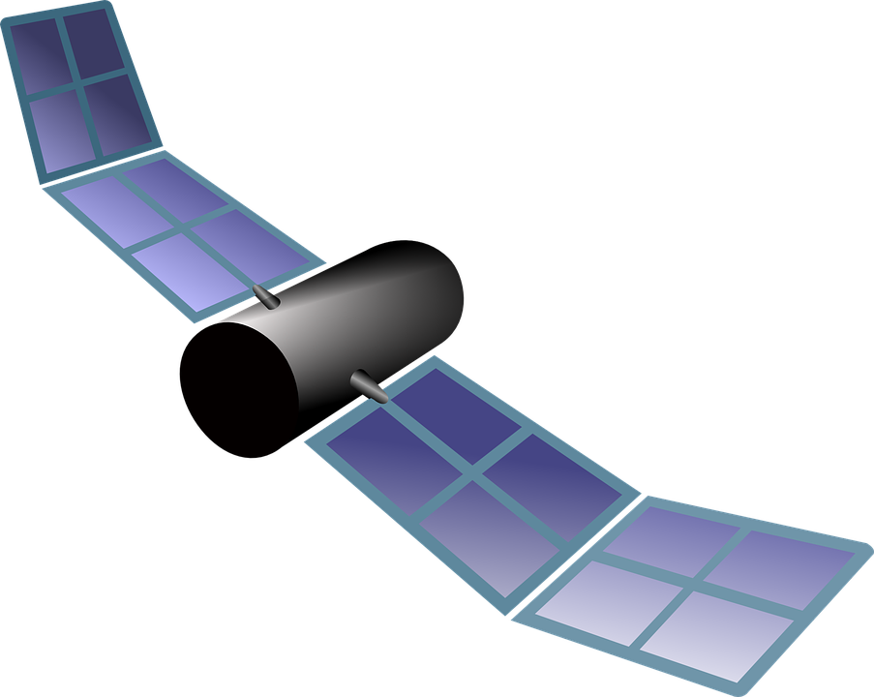
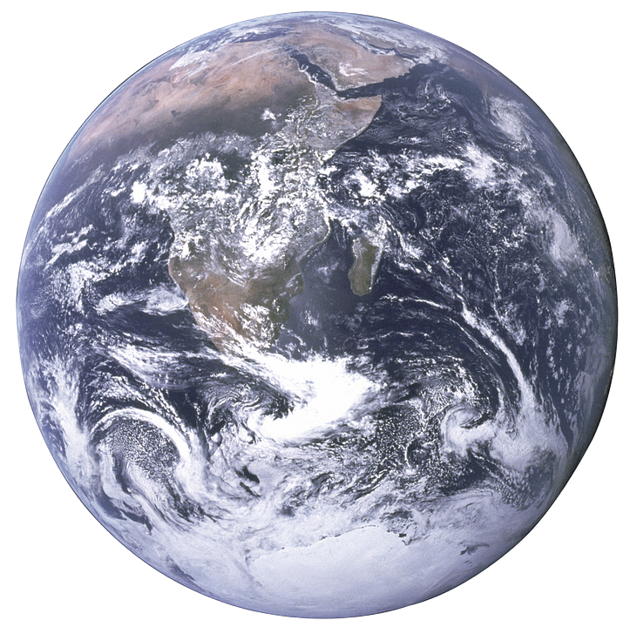
Where does GIS data come from?
- Global Positioning System (GPS)
- constellation of satellites
- Originally government military use
- now open to anybody
- Work through triangulation

Slide 4
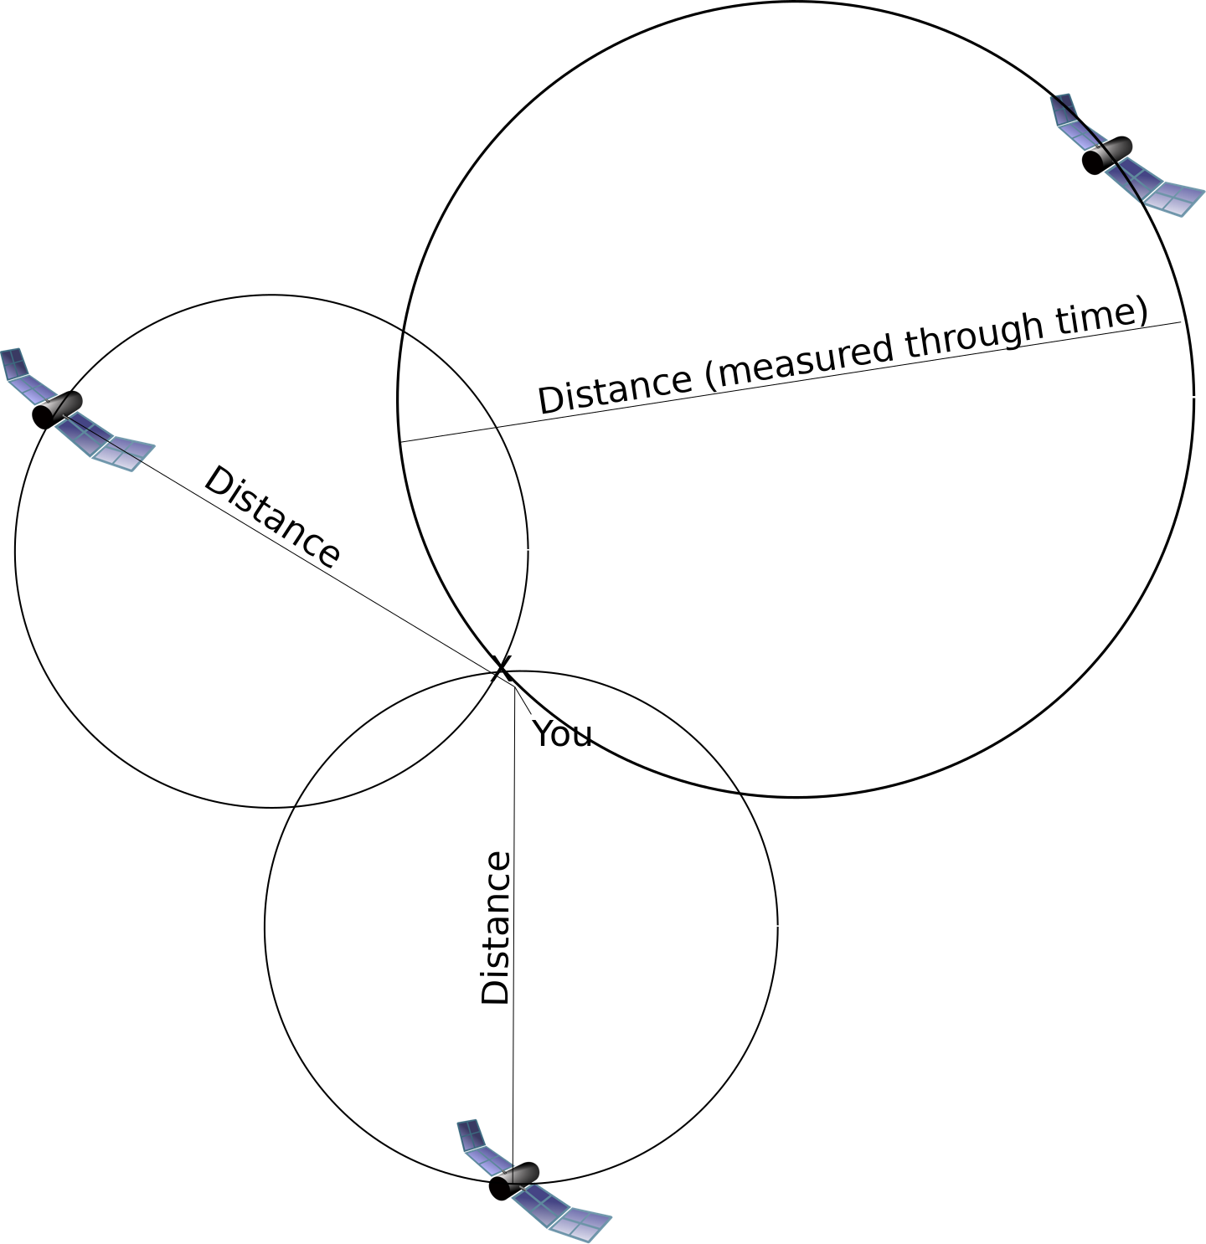
GPS
More satellites = less error

Slide 5
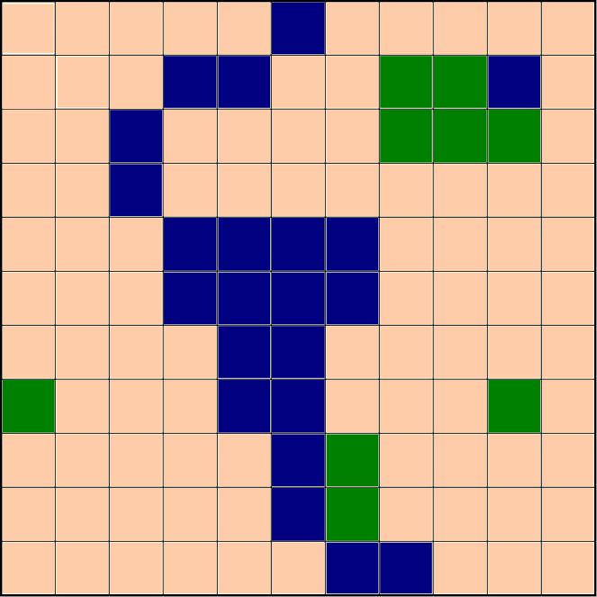

GPS
Can be used to directly generate vector data
- Point data (long, lat)
- Tracks can be used to create lines (roads/rivers) and polygons (buildings, fields, forests)

Slide 6
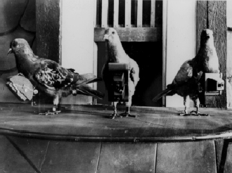
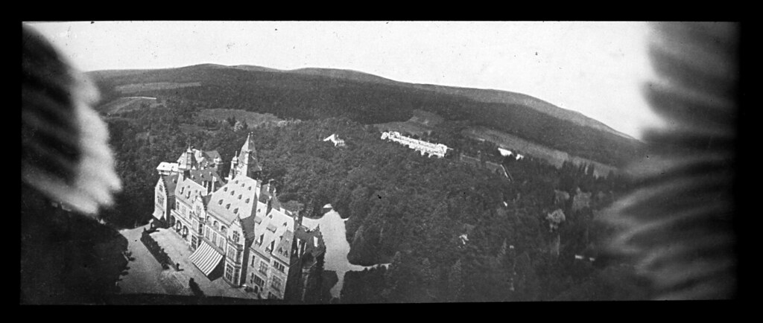
Remote Sensing
Besides balloons and kites, pigeons were used to carry cameras
and could be trained to fly over targets
German scientist
Dr. Julius Neubronner

Slide 7
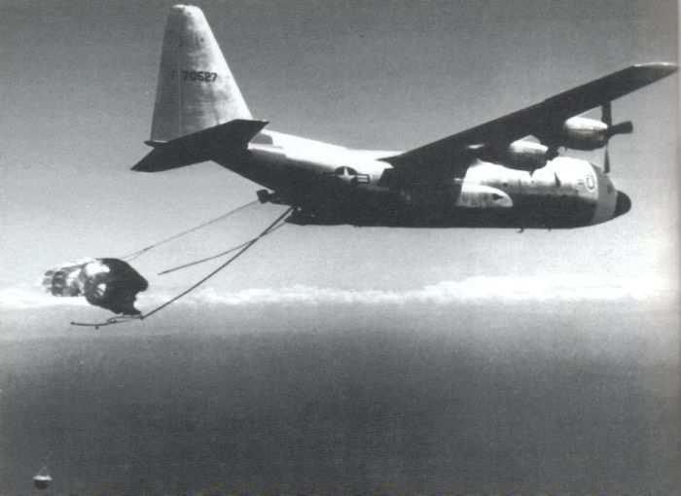
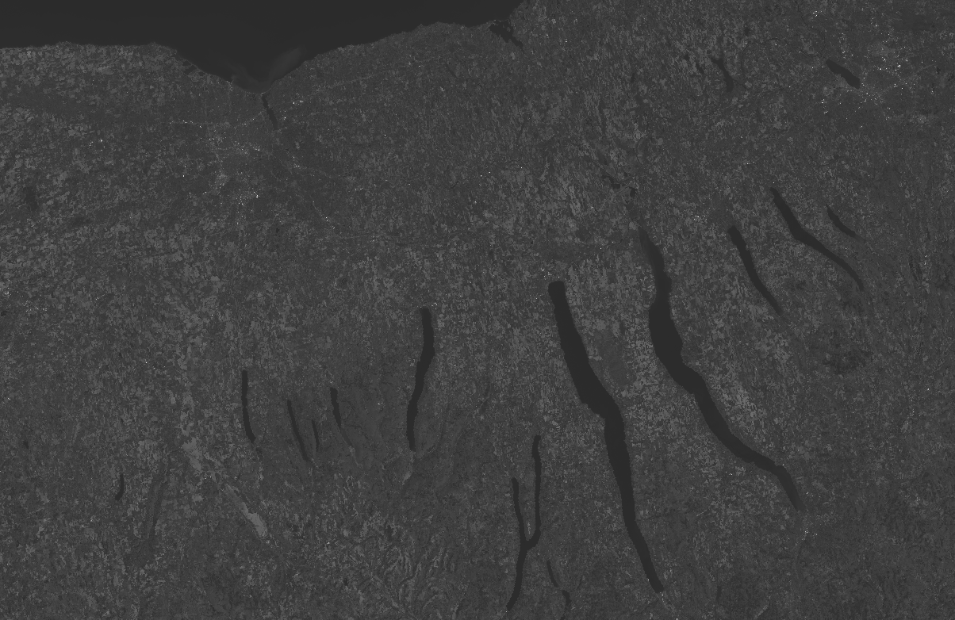
Remote Sensing
CIA’s declassified Corona Program
NASA’s LandSat8 satellite

Slide 8
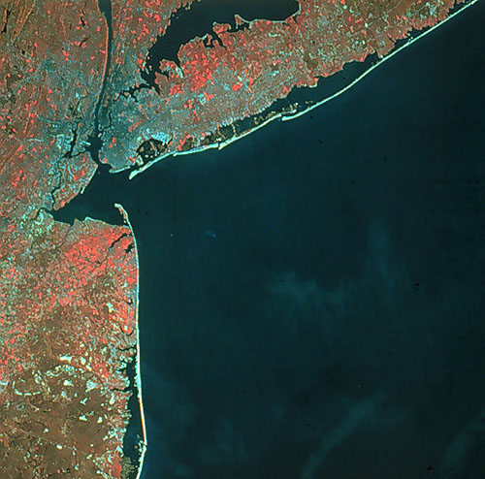
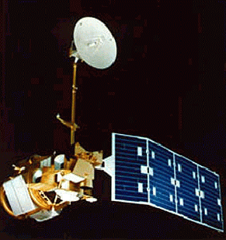
Remote Sensing – past and present
Notes:
1
1
Before satellites, remote sensing images were obtained in a variety of creative ways. Early remote sensing images in the mid to late 1800s were taken by hot-air balloonists. In 1897, Alfred Nobel (for whom the Nobel prize is named) took the first aerial photograph from aboard a rocket. In the early twentieth century, remote sensing images were even taken by cameras strapped to fleets of pigeons and kites. As technologies advanced throughout the 1900s, remote sensing via cameras aboard airplanes became valuable for things like wartime reconnaissance, urban development, disaster damage assessment, land use surveys, agricultural status, and oil exploration. But it wasn't until the latter half of the twentieth century, with the development of artificial satellites, that remote sensing expanded to the global scale. Today, more than a dozen NASA satellites keep constant watch over Earth.

Slide 9
GIS and RS
Species distributions: conservation, systematics (e.g. phylogeography)
Global processes
Land and sea cover and use
Land and environmental management
Protected areas
Disaster management
Notes:
GIS has the potential to increase the predictive power of SDMs, making more realistic models…
We can use GIS as a tool to predict land use/cover into the future based on current patterns.
Go through a series of conservation issues and examine how GIS and RS can be used

Slide 10
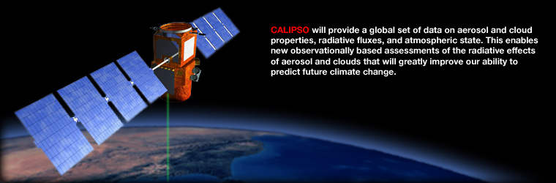
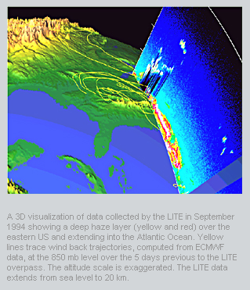
Air Quality
MAPS
Measures distribution of CO 3-10km above the earth’s surface
Near global CO database
TOMS
Measures ozone, UV, aerosols, and volcanic ash emissions
Landsat 7 and Calipso
Air Pollution Monitoring
Ozone, CO, Sulfur Dioxide, Nitrogen Dioxide
Measure the proportion of light blocked by particulate matter for atmospheric modeling of contaminants
Source: NASA
Notes:
1
-Several sensors on satellites specifically designed to measure the dynamics of atmospheric column
Carbon monoxide in earths lower atmosphere (3 – 10 km) measured by NASA’s MAPS instrument
Provides a global database of atmospheric CO levels to measure how pollutants travel from sources, size etc.
NASA’s Earth Probe Satellite’s TOMS instrument: ozone UV, aerosols, volcanic ash emissions (sulfur dioxide)

Slide 11
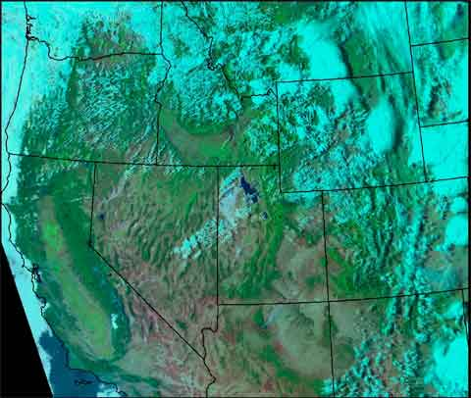
Weather and Climate Data
Instantaneous data on local, regional conditions
Longer-term climatological summaries
Changes in mean, variance
source: U.S. Forest Service
Notes:
1
- Weather and climate are the principle drivers of ecological patterns and processes.
- Remote sensing has dramatically increased the availability of climate data, especially for geographic regions in which ground-based weather stations are few and widely dispersed.
- Selection of climatic data for ecological models should be based on the target response variable and the purpose of the model.
- Plants and animals with short generation times, and the probability of phenomena such as fire or flood, often are sensitive to short-term fluctuations in temperature and precipitation.
- Species with longer generations times, and longer-term changes in land cover, may be more closely associated with climate patterns over time.
- In some cases, changes in the variance in temperature, precipitation and weather events may be more influential than long-term averages.

Slide 12
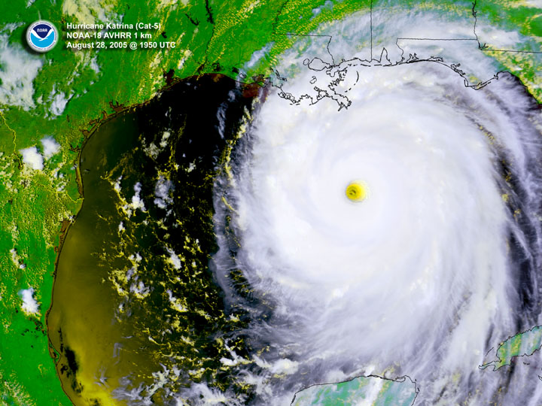
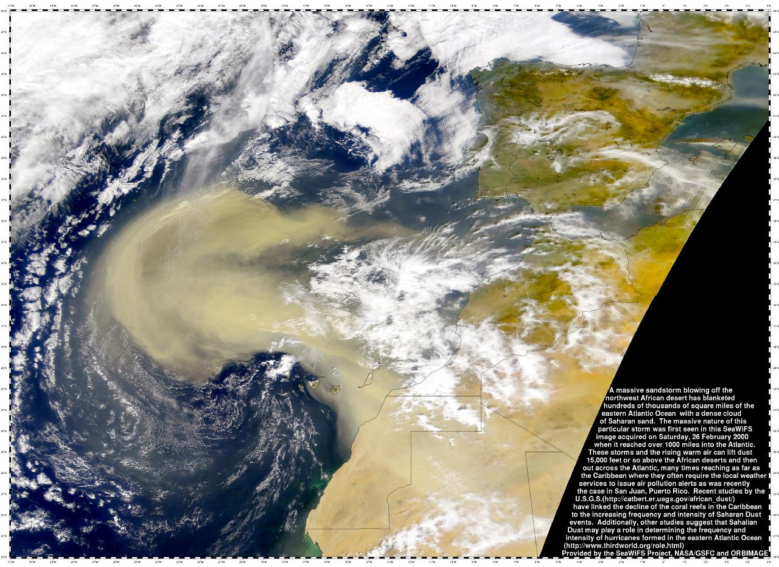
Weather Monitoring
Hurricane Katrina
Source: http://seawifs.gsfc.nasa.gov/SEAWIFS/IMAGES/Africa/
S2000057133341.L1A_HDUN_CAN.SaharanDust Storm.small.jpg
http://www1.ncdc.noaa.gov/pub/data/images/hurr-katrina-20050828-n18rgb.jpg
https://www.youtube.com/watch?v=84Nc7e7pqw4
African Dust storm
Notes:
1

Slide 13
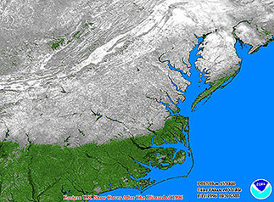
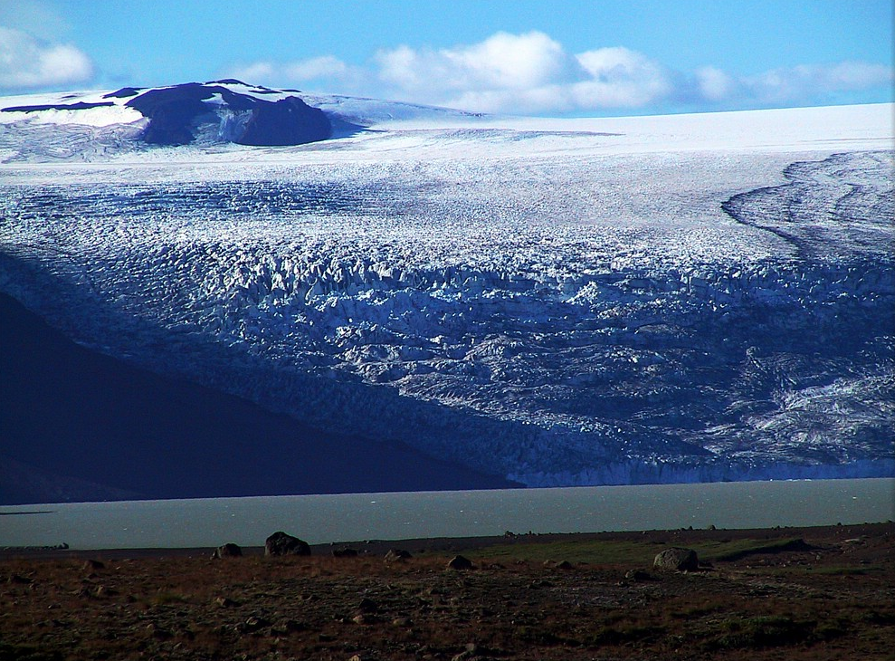
Aquatic Ecosystems
Runoff
Flooding
Water quality
Water body extent
River flow rates
Wetlands mapping
Water surface elevation and depth
Ocean color
Coral reef mapping
Benthic habitat
Oil spill monitoring
Source: NOAA
Source: Harri Eliasson
Notes:
1
- Remote sensing is used to map and monitor a number of different features in ocean and inland water ecosystems.
Some of the items listed on this slide are addressed in the following slides.

Slide 14
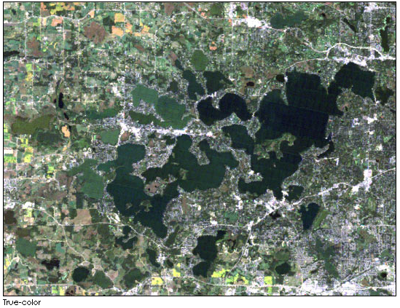
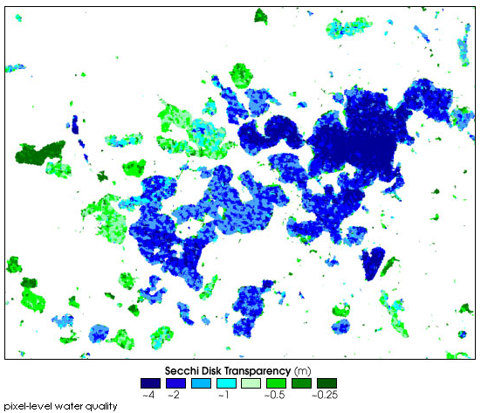
Hydrology
Hydrologic Modeling:
Watershed geometry
Drainage network
Empirical Equations
Annual runoff, Flood peak, Low flow
Runoff Modeling:
Land use
Soil moisture
Topography
Water Quality:
Suspended sediments
Estimate chlorophyll
Temperature
Turbidity
Eutrophication
Source: NASA
Source: NASA
Notes:
1
-Remote sensing can be used for determining watershed geometry and drainage network for hydrologic models and for empirical flood peak, annual runoff or low flow equations.
Sensors also provide input data such as land use, soil moisture, and topography for runoff modeling. Remote sensing techniques can be used to assess several water quality parameters largely because of the curvilinear relationship between suspended sediments and sensor reflectance.
Eutrophication of a water body (when high concentration of nutrients in a water body stimulates the bloom of algae; though part of the natural aging process, exacerbated by humans and considered “pollution”) is usually quantified in terms of the concentration of the chlorophyll contained in the algae/plankton.
Thermal discharge into streams, lakes and coastal waters from electrical power plants has been mapped with remotely sensed data (Gibbons et al., 1989).

Slide 15
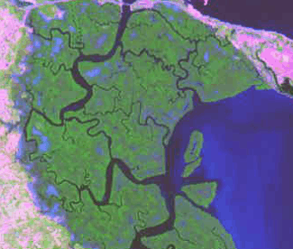
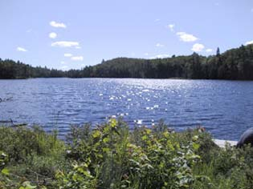
Wetlands
Understanding of wetland habitat linkages and the complex habitat needs of wetland species
Input on identification, classification and inventory, ecological studies, hydrologic studies, and monitoring change
Source: NASA
Source: The Nature Conservancy
Notes:
1
Hydrologic parameters are highly dynamic, therefore the timely, repetitive coverage made possible with satellite sensors are an attractive source of monitoring information.
The disadvantage of satellite data and spectral analysis is related to the natural heterogeneity of wetland communities and resulting vegetation gradients. There are also many spectral classes in uplands that can duplicate those in wetlands. Therefore, inclusion of ancillary data (e.g., DEM, watershed and estuary maps) can help improve mapping the habitats of numerous wetland (including endangered) species.

Slide 16
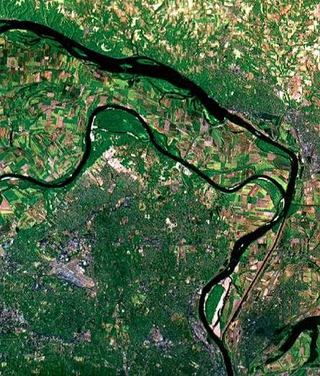
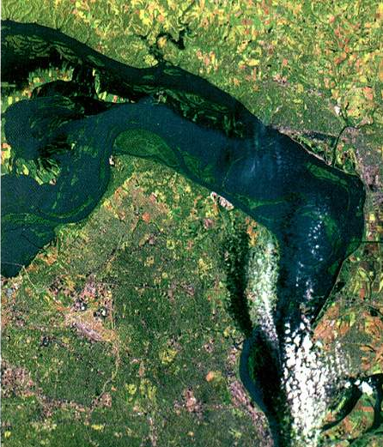
Flooding
Compare imagery from before a flood event and at different stages as it peaks and recedes.
Overlaying GIS layers provides information about the areas that have been inundated.
Map extent of flooded forests
Pre- flood
Peak-flood
Confluence of Mississippi and Missouri Rivers
During Flood of 1993
Source: NASA/Goddard Space
Flight Center
Notes:
1
Satellite imagery can be useful to monitor flooding events. The top image shows the confluence of Missouri and Mississippi rivers before the ‘Flood of 1993.’ The below image is taken during the peak of the flood. In a typical damage mapping scenario, a ‘before’ image of the damaged area is often overlaid on ‘during’ or ‘after’ image to determine extent and pattern of damage.

Slide 17
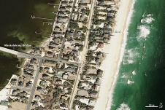
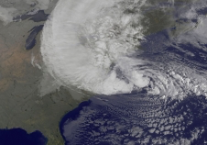
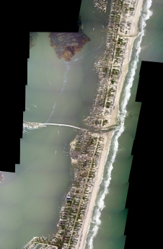
Weather after-effects
Hurricane Sandy, Monday October 29
Mantoloking New Jersey
Notes:
NOAA's GOES-13 satellite captured this visible image of Hurricane Sandy battering the U.S. East coast on Monday, Oct. 29 at 9:10 a.m. EDT. Sandy's center was about 310 miles south-southeast of New York City. Tropical Storm force winds are about 1,000 miles in diameter.
Photo of the New Jersey coastal town of Mantoloking taken on March 18, 2007.
Image Credit: Aerial photography courtesy of the NOAA Remote Sensing Div.
Photo of the New Jersey coastal town of Mantoloking, just north of where Hurricane Sandy made landfall, taken on October 31, 2012 shows the damages caused by Hurricane Sandy.
Image Credit: Aerial photography courtesy of the NOAA Remote Sensing Div.
1

Slide 18
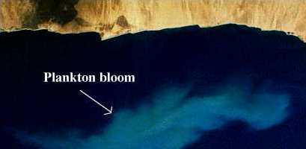
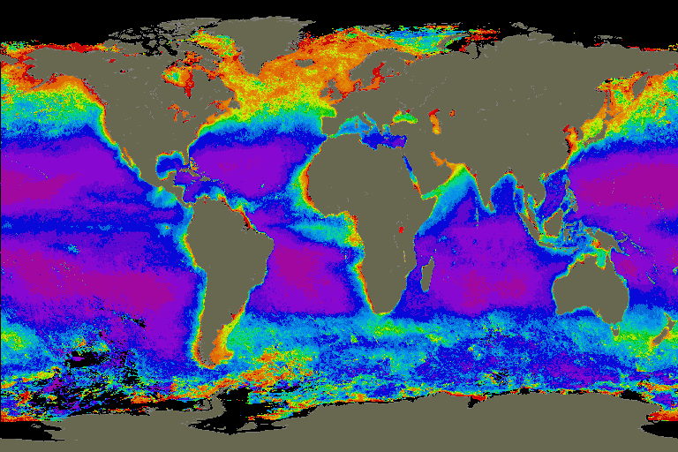
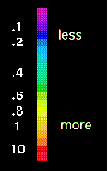
Monitoring Ocean Color
Surges in phytoplankton appear as sudden bright blooms in satellite images
In contrast, relatively low fluorescence indicates a healthy area and appears darker
Primary productivity can be measured by determining the amount of light absorbed by phytoplankton chlorophyll
Sensors detect variations in the intensity of light, called ocean color, at the ocean surface
Specific bands detect chlorophyll absorption
Source: NASA
Source: NASA
Notes:
1
For the most part the oceans appear blue, however, this color is modified by microscopic marine algae, called phytoplankton.
The top picture in this slide is a satellite image that shows a high concentration of phytoplankton. The lower picture shows varying levels of chlorophyll activity around the globe.
During photosynthesis, chlorophyll (green pigment) absorbs light, which allows plants to produce organic carbon (carbohydrates) from carbon dioxide and water. The amount of organic carbon plants produce (primary productivity) can be measured by determining the amount of light absorbed by phytoplankton chlorophyll. When sunlight enters ocean water, it bounces around on particles, phytoplankton, and water molecules, and then bounces back up toward space. The instruments detect variations in the intensity of light, called ocean color, at the ocean surface. For example, the SeaWiFS instrument measures light absorption at particular wavelengths (bands). Specific bands on the sensor detect chlorophyll absorption.
As the concentration of chlorophyll increases, images of ocean surface change from blue to green to red. The scale units are mg/m3 chlorophyll.

Slide 19
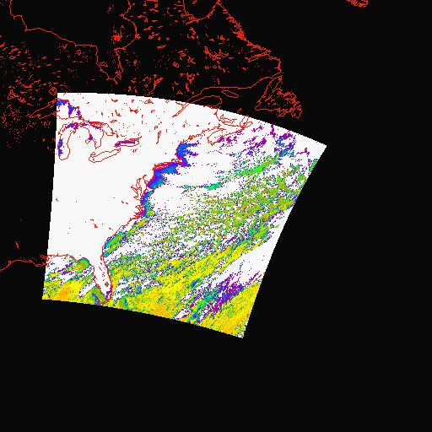

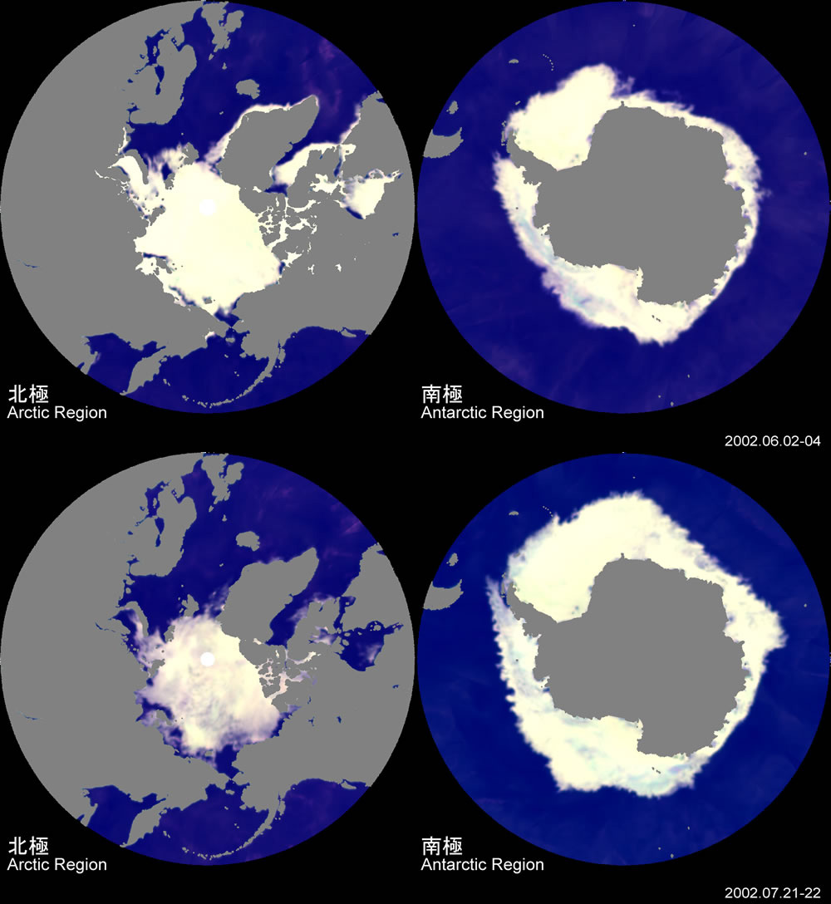
Sea Surface Temperature and Sea Ice
SST
Thermal infrared (TIR) observations
Measure thermal infrared radiance from sea surface in two different wavelengths
Calculate "brightness temperatures”
Convert calibrated radiances to temperatures
Sea Ice
Passive Microwave Sensors
Salinity
Surface roughness
Surface wetness of ice
Uses:
Locate, monitor, and evaluate sea ice movement
Source: NOAA
Source: NASA
Notes:
1
Sea surface temperature (SST) estimation using infrared observations, and sea ice location, monitoring, and evaluation using passive microwave sensors.
In the top image, data from the AVHRR sensor was used to calculate brightness temperatures using two bands measuring infrared thermal radiance.
These data are calibrated and converted to SST using conversion tables and mapped.
Sea ice is tracked using passive microwave because of its sensitivity to variations in salinity, surface roughness, and surface wetness of ice (refer class to bottom illustration).
Because passive systems only detect natural microwave energy, the energy available is quite small compared to active radar. Because microwaves are so long, the fields of view in passive microwave sensors must be large to detect enough energy to record a signal. Most passive microwave sensors are therefore characterized by low spatial resolution.

Slide 20
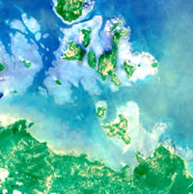
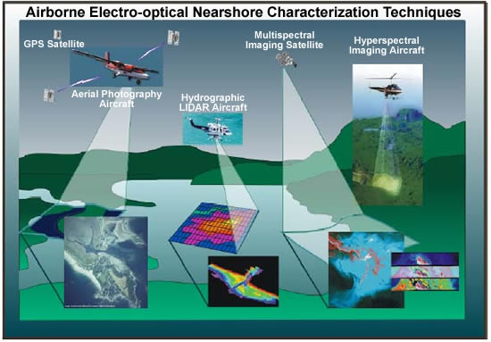
Monitoring Benthic Habitats
Challenges
Imagery must penetrate the water and capture the seafloor
Techniques
High-resolution optical satellite images
Digital aerial photographs
Active microwave images
Optical (video, still cameras, lasers)
Physical (shipboard acoustic surveys)
LIDAR – narrow high frequency laser beam from aircraft : When the laser beam hits the water, part of the energy is reflected off the surface and the rest travels through the water column and reflects off the seafloor. The sensor records the time it takes for the reflected signals from the surface and seafloor to return to the aircraft. The water depth is calculated from the time difference between the returns.
Source: NASA, JPL
Source: Science Applications International Corporation
Notes:
1
High-resolution, active microwave systems can provide information on near-shore benthic and shallow reef habitats.
These sensors penetrate the water and capture descriptive information of seafloor features including corals, seagrass, sand, and shellfish beds through the use of processing techniques similar to algae detection.
High-resolution optical sensors and digital aerial photography are also used to identify shallow seafloor features for visual interpretation and mathematical modeling and are typically used in conjunction with other data sources.
Optical (video, still cameras, lasers) and physical (shipboard acoustic surveys) sampling techniques are used for fine scales of the seafloor and provide greater accuracy and detail than spaceborne and/or airborne sensors.

Slide 21
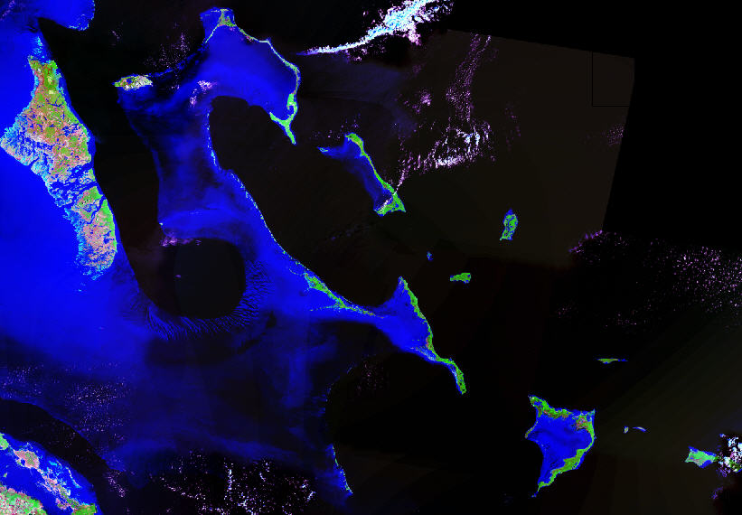
Remote sensing of coral reefs
Notes:
1

Slide 22
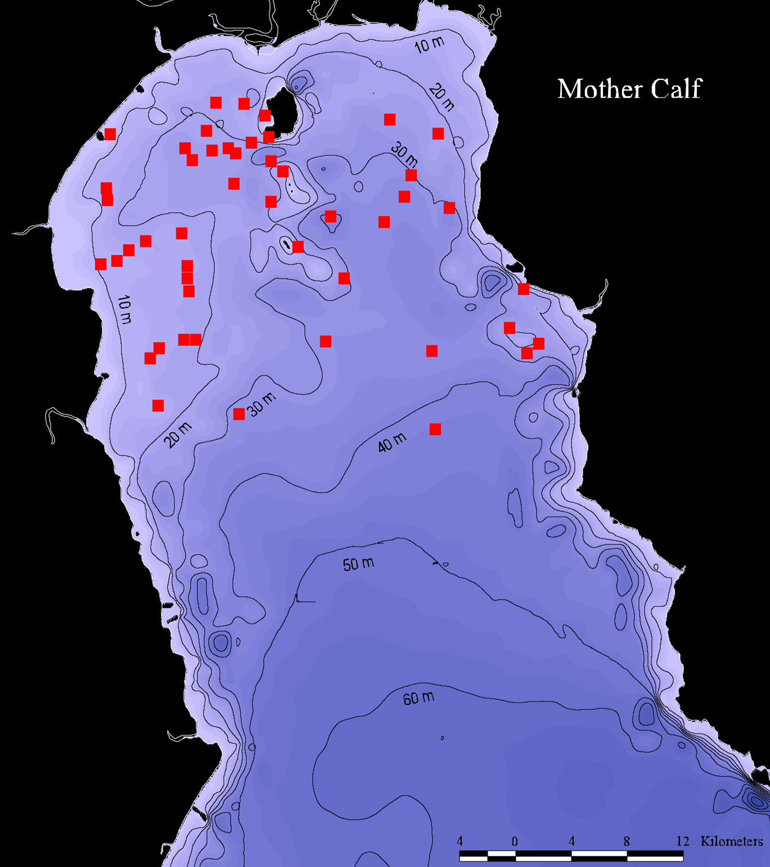
Cetacean habitat use
Assess habitat use and population distribution.
For example, Mother/calf significantly distributed within and around 20m isobath.
Areas where come into contact with human interests.
Individual positions linked into database.
Superimpose different data layers (AVHRR, SeaWhiffs & TOPEX).
Notes:
Showed that when babies small, mothers hang out in shallow water for better buoyancy because they have to lift a one ton baby up to breathe – relates to fishing permits/access during that time of year.

Slide 23
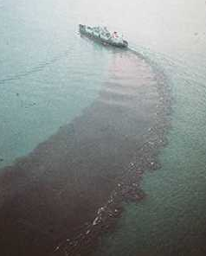
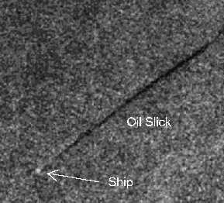
Oil spill detection, mapping and monitoring
© Greenpeace
Smooth sea
Oil slick
Rough sea
Notes:
1
The majority of marine oil pollution is caused by oil discharged from tankers during cleaning rather than from accidents. Each week, the amount of oil dumped into the ocean in this way is equal to the amount from a full tanker.
Remote Sensing can be used to monitor oil spills. An oil slick gives less backscatter than the surrounding water, thus it appears darker on the satellite image.
Source: http://seaspace.esa.int:8000/exercises/ex3.html

Slide 24
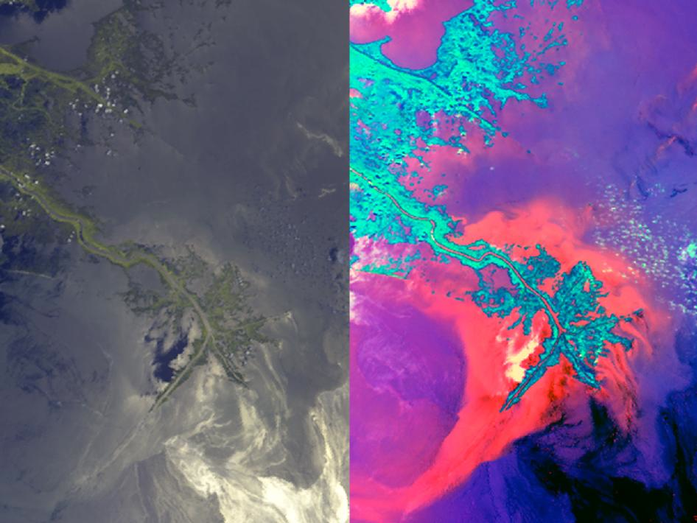
Notes:
Multiple cameras on JPL's MISR instrument on NASA's Terra spacecraft were used to create two unique views of oil moving into Louisiana's coastal wetlands. Image Credit: NASA/GSFC/LaRC/JPL, MISR Team
1

Slide 25
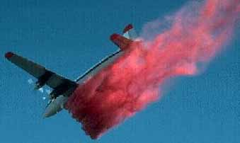
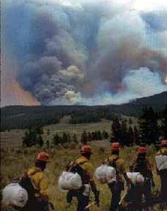
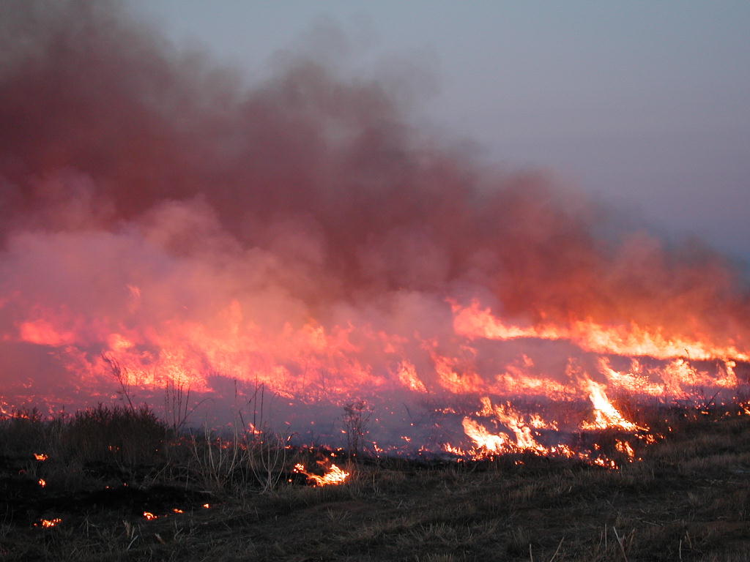
Fire Mapping and Prediction
During Fire Goals:
Detection
Behavior
Monitoring
Prediction
Post-Fire Goals:
Assessment
Burn severity
Mapping
Rehabilitation
Fire behavior dependent on:
Fuel
Weather
Topographic Factors
Source: U.S. Forest Service
Source: U.S. Forest Service
Notes:
1
During a fire event, ‘detection’ relates to the exact position of the wildland fire. How it is developing and spreading is labeled its ‘behavior.’ ‘Monitoring’ relates to how it has progressed over time, and how it is likely to develop into the future is labeled ‘behavior prediction.’
After suppression, it’s necessary to determine the type and extent of damage (fire scar) and to plan for recovery actions (assessment, mapping, and rehabilitation). Three elements that control the behavior of wildland fires are listed.
Fire behavior is dependent upon:
1)Fuel which is characterized by biomass condition, biomass quantity, moisture content, and vertical and horizontal structure (continuity)
2)Weather which is characterized by wind velocity, wind direction, relative humidity, precipitation, and temperature.
3)Topographic factors such as slope and aspect, elevation, shape of terrain.

Slide 26
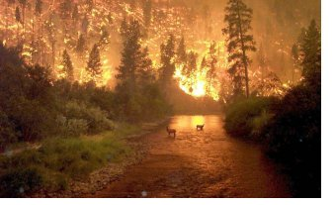
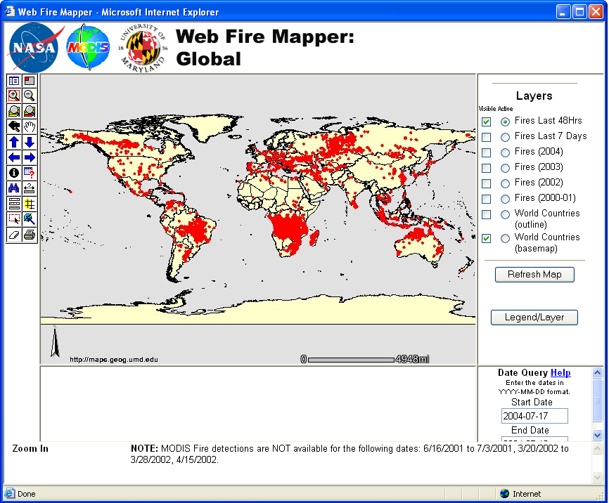
Fire Monitoring
Frequent wide area coverage of satellite remote sensing provides:
Location
Frequency
Spatial distribution
Fire Phases
Active
Smoldering
MODIS
Detects flaming and smoldering
Near real-time monitoring capability
Source: National Weather Service, Sioux Falls
Source: NASA
Notes:
1
Biomass burning combusts Earth’s vegetation (in forests, savannas, grasslands), operates over huge areas of the Earth’s surface, and results in vast amounts of particulates and pollutants in the atmosphere.
Satellite sensors can provide near real-time information (as illustrated, WebFireMapper is a web-based near real-time global fire monitoring application using NASA’s MODIS) on location, frequency, and spatial distribution of wildland fires. MODIS can detect fires in two phases: active and smoldering. Although the rate of combustion is higher during the flaming phase, more smoke, aerosol particles and greenhouse gases are emitted during the smoldering phase due to the lower combustion efficiency. Hence, impact of biomass burning on regional pollution, and, potentially, on global climate change can be better understood.

Slide 27
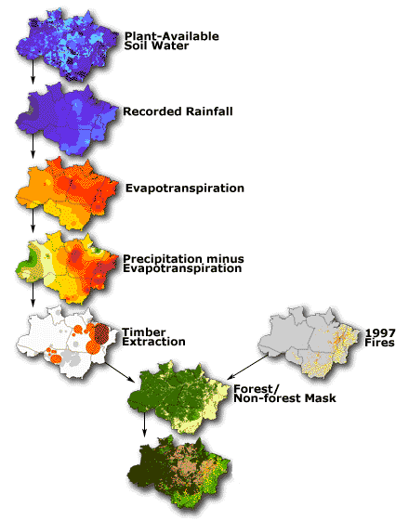
Areas of Fire Risk
Source: http://www.ipam.org.br/fogo/ppt-peten.htm
Notes:
1
These images from the Amazon Basin in Brazil, show how data input into a GIS system can be used to determine areas prone to forest fires.
By examining climatic patterns it is possible to predict and map the level of fire risk in different regions.
Areas with higher fire risk will have received little rain over the course of a season. They may also be areas where fire is commonly used in agriculture.
The first map shows soil water capacity, with purple indicating maximum capacity to retain water.
To create the second map, monthly rainfall maps were added together, to produce accumulated rainfall from May 1997 to September 1998. (purple is maximum precipitation or 2,500-3,000mm)
Based on average monthly temperature, it was possible to determine which areas would have the highest evapo-transpiration rates during the same period.
By subtracting evapo-transpiration from rainfall received, you can produce a map indicating areas of suspected drought. Yellow, orange and red indicate increasing levels of drought.
Logging intensity was then mapped. With the darkest areas having the highest intensity. This was mapped since logging opens the canopy and exposes the forest floor to the sun causing it to dry more rapidly.
Finally, areas where fires occurred in 1997 were mapped. The assumption was made that areas which were on fire in 1997 would be more likely to catch fire in 1998.
A vegetation map indicating forested to non-overforested areas was then overlaid on the other maps as a different model was used to predict the risk of fire in each of these areas.
Based on these models, areas most susceptible to fires were determined. In non-forested areas green indicates no fires suspected while red indicates many fires. In forested areas, dark brown indicates low risk while light brown indicates high risk. These risk factors can be used to plan appropriate fire management for these areas.

Slide 28
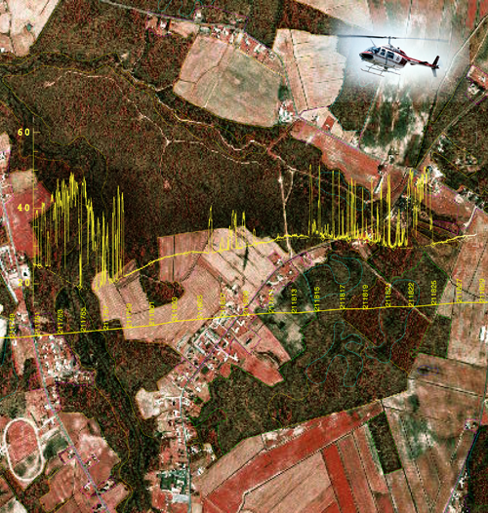
Forestry
Tree height
Volume
Stand density
Biomass
Leaf area index
Structure
Forest Health
Source: Ross Nelson, NASA Goddard Space flight Center
Notes:
1

Slide 29
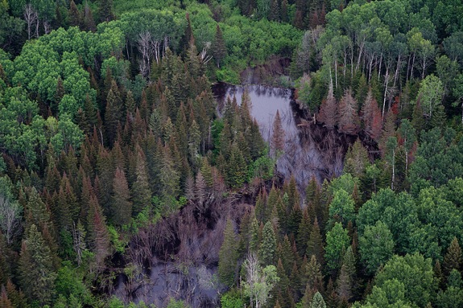
Notes:
http://blogs.smithsonianmag.com/science/2013/02/scientists-see-insect-outbreaks-from-space/
Warmer temperatures and drought conditions prolong the life cycle of mountain pine beetles, allowing them to prey on the pine, spruce and fir trees that blanket the mountains. The trees turn reddish-brown before dying off–a phenomenon the National Park Service deemed “an epidemic stretching from Canada to Mexico.”
<number>

Slide 30
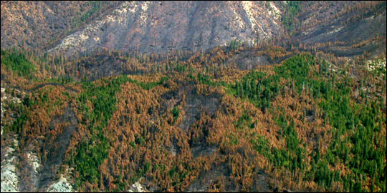
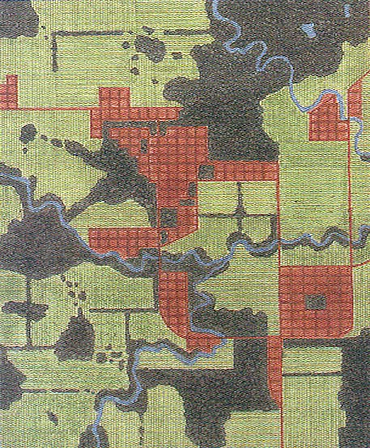
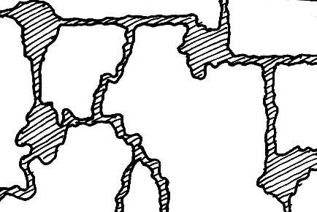
Landscapes
Land Use Land Cover Change (LULCC)
Repeated inventories of land use and land cover from space
Simulation of processes (land conversion and use) taking place on the ground
Landscape ecology
Spatial patterns of landscapes can be observed and documented to model landscape metrics and indicators.
Source: University of Idaho
Notes:
<number>
Several techniques can be applied to examine landscape structure, function, and change. Land use and land cover change (LULCC) mapping is a remote sensing application that utilizes land cover information based on time series to simulate land conversion and use on the ground over time.
Landscape ecology makes use of quantitative models depicting spatial patterns of land cover types (homogeneous vs. heterogeneous, patchy vs. smooth, regular vs. irregular).
Use of GIS, to integrate remote sensing data with other information (thematic maps such as existing protected areas, transportation routes, towns and cities) is used to model species habitat, richness, its proximity to conserved areas, whether the habitat is linked or exist in isolated islands, and rankings based on conservation priorities.

Slide 31
Patches and Landscapes
Patch: land cover is continuous, invariant
Landscape: mosaic of patches of two or more land-cover types
Notes:
<number>
RS has made it much easier to quantify many of the landscape metrics that ecologists use to understand and predict the distribution of species and assemblages across space and time. Before considering directly how remote sensing facilitates characterize of landscapes, it may be helpful to review how several key landscape metrics are defined and why they are relevant to various types of ecological models.
A patch is a discrete area in which land cover largely is continuous and invariant. A patch also may be defined as a recognizable area that contrasts with adjacent areas and has definable boundaries.
A landscape, in turn, is a mosaic of patches of two or more land cover types. The mosaic may be created by natural phenomena, human land use, or both.
After the attributes of patches relevant to a particular modeling effort have been defined, remote sensing often can be employed to identify and delineate those patches.

Slide 32
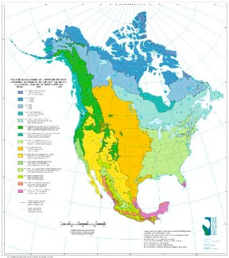

As Resolution Increases, Landscapes Appear More “Patchy”
Level I: 15 broad ecological regions
Level II: 52 ecological regions
source: U.S. Environmental Protection Agency
Notes:
<number>
In principle, delineation of patches is independent of the resolution and extent of measurement. In practice, delineation of patches is influenced by the ecological processes, land uses, or species of interest.
As resolution of observations and mapping increases, a landscape appears to be more “patchy” or heterogeneous. What may appear to be the same land cover type on a continental or regional scale is likely to appear as many different land cover types at finer resolution.
As shown in this slide, the U.S. Environmental Protection Agency analyzed spatial patterns of biological and physical features such as geology, topography, land cover, land use, and climate to classify ecoregions of the conterminous United States at multiple levels (four, to date). At the coarsest resolution, Level I, the landscape is divided into 15 regions; Level II includes 52 regions.
Resolution influences selection of sources of remote-sensing data. For some applications, such as mapping major land cover types across a province or country, the 30 meter resolution of Landsat imagery is sufficient. For other applications, such as identification of riparian areas in arid regions with limited ground access, SPOT data at 5 meter resolution may be more appropriate.

Slide 33
Advantages of RS and GIS
Cost-effective method of monitoring land cover and use
Allow monitoring of global processes
Can observe remote areas
Enable the integration of many different types of data
Encourage better information management
Facilitate historical comparisons
Create a clear and striking visual product
Develop and compare options for future land use
Notes:
<number>
Remote Sensing has given us a new perspective of the earth’s processes and land use patterns. It provides a cost-effective tool to monitor changes in land cover and use. It also is one of the only ways to monitor large-scale and global processes. Remote Sensing can allow us to observe remote or difficult to access areas.
In combination with GIS, it allows us to integrate information in new ways and provides us with an increased understanding of the complex processes that link ecosystems together. With GIS, physical, biological and socio-economic information can be combined to give a complete picture of a region. Linking different data in one system, encourages better information management and also facilitates historical comparisons by standardizing data.
A GIS analysis produces a clear, visual image of conservation and land use needs that can be easily understood by decision-makers and communities. In turn, this facilitates decision-making.
Finally, GIS can be used to consider different options and model different land uses. This can ensure better land use planning in the future.

Slide 34
Limitations of RS and GIS
Cost of satellite images, software and equipment
Cloud cover
Error in data interpretation
Satellite coverage
Lack of visible light
Large data storage needs
Limited historical data
Lack of good species data
Notes:
<number>
While RS and GIS can be excellent research tools, there are a number of limitations to their use.
One of the major problems is the cost of satellite images and equipment. To reduce costs, several organizations can purchase images jointly. Also, Landsat 7 images are cheaper and more data is available via the Internet.
The cost of images is compounded by the need to buy many images in areas where cloud cover is high. This can be a particular problem for Vietnam, where areas of humid forest tend to have thick cloud cover. Unlike aerial photos, you can not pick ideal conditions (except in rare cases and for a large amount of money) for the satellite pass over an area. (This problem can be offset by using radar images which can penetrate cloud cover; however, these images are harder to interpret and there is limited historical data.)
Because a satellite image covers a particular grid, if your study site overlaps more than one image costs will increase dramatically.
In some areas of the world, satellite coverage (that is the number of satellites that actually pass over a particular place can be a problem). Generally, this is not an issue in Vietnam. Because RS and GIS create large files, large data storage capacity is needed.
Historical comparisons are limited since satellite images have only been available since 1972. For GIS applications, the lack of adequate species data is a constraint. Data can be also misinterpreted especially if vegetation is not spectrally uniquely. For example, in the images of Chicago during a dry year wetlands gave emitted the same spectral wavelength or signature as grasslands.

Slide 35

Population distributions
Nighttime lights - November 27, 2000
http://antwrp.gsfc.nasa.gov/apod/image/0011/earthlights2_dmsp_big.jpg
Notes:
<number>
The following image is of Southeast Asia at night. This is one other limitation. If a satellite passes over an area at night, the data it receives is limited. However, night images can be useful to see detect urban areas, since lights are visible as in this image. They ca also be used to detect fires. In the polar regions, lack of visible light can be a major problem since for many months there is no light.

